Slide 1



1^{ο} Congress of Local Development of Halkidiki, Nea Moudania
LOCAL CLLD PROGRAM OF HALKIDIKI
PRIORITY 4.2. FISHERIES OP. PROGRAM
Speaker: Tassos Livadiotis, ANETXA SA

Slide 2
Submission of the Local Program
Call of Interest: June 2016
Design based on “bottom-up” approach -Consultation (March – June 2016): 8 seminars & workshops with participation of 193 representatives of Public, Private and Citizens’ groups
Submision: September 2016
Evaluation results: October 2016
Our Local Program was evaluated as 1st in total of 49 Local programs

Slide 3
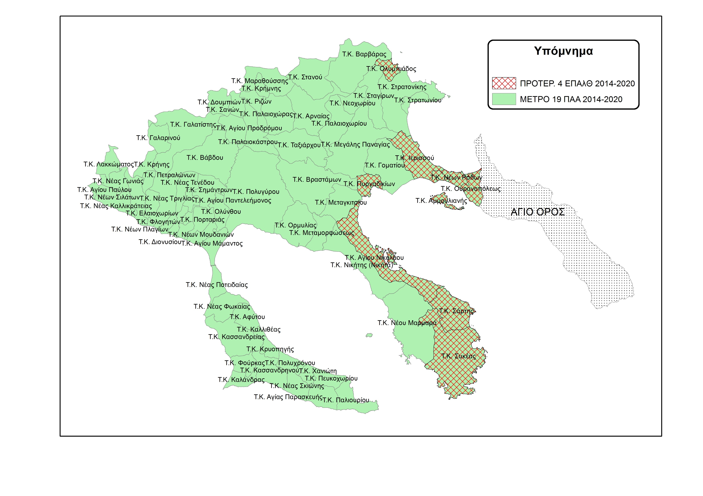
The 2 Local programs
(implementation area)
Measure 19 «(CLLD) – LEADER» of National Rural Development Program 2014 -2020
Priority 4 of National Fisheries Operational Program 2014-2020

Slide 4
The 2 Local programs
(budget allocation)
Measure 19 «(CLLD) – LEADER» of National Rural Development Program 2014 -2020
TC: 10.693.162,39 €
PC: 8.350.000 €
Priority 4 of National Fisheries Operational Program 2014-2020
TC: 3.500.000 €
PC: 1.950.000 €

Slide 5
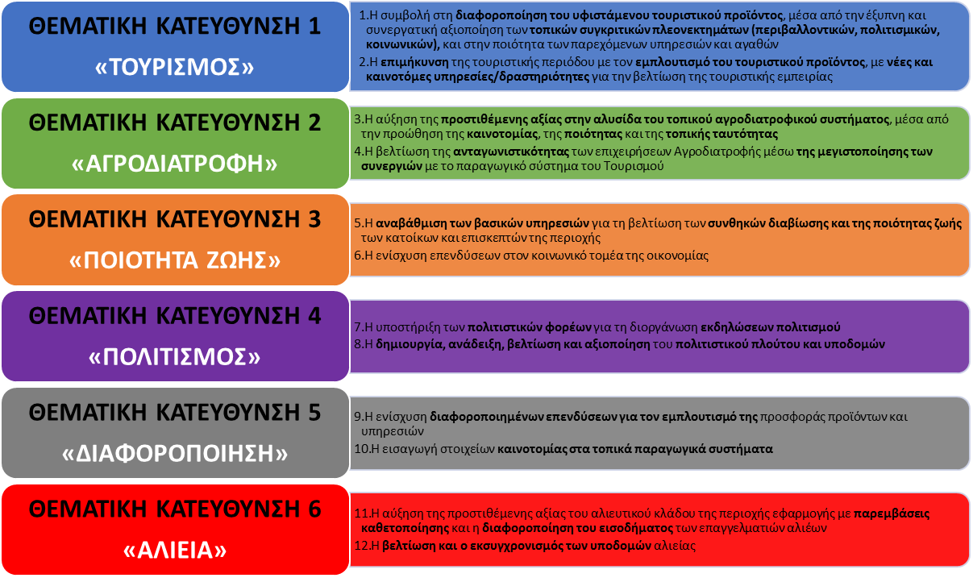
6 Thematic areas - 12 Objectives
THEMATIC AREA 6: “FISHERIES” :
Obj.11: To increase the added value of the fisheries sector through interventions of vertical integration, and to differentiate the sources of income of professional fishermen
Obj.12: The amelioration and modernization of fisheries infrastructure

Slide 6
Budget Allocation per Thematic Area
ΘΕΜΑΤΙΚΗ ΚΑΤΕΥΘΥΝΣΗ 1: «TOURISM» | ΘΕΜΑΤΙΚΗ ΚΑΤΕΥΘΥΝΣΗ 2: «AGRIFOOD» | ΘΕΜΑΤΙΚΗ ΚΑΤΕΥΘΥΝΣΗ 3: «QUALITY OF LIFE» | ΘΕΜΑΤΙΚΗ ΚΑΤΕΥΘΥΝΣΗ 4: «CULTURE» | ΘΕΜΑΤΙΚΗ ΚΑΤΕΥΘΥΝΣΗ 5: «DIFFERENTIATION» | ΘΕΜΑΤΙΚΗ ΚΑΤΕΥΘΥΝΣΗ 6: «FISHERIES»

Slide 7

Priority 4 - Fisheries Program
Action 4.2.1: Private Investments
Α.1 – Establishment, modernization of Food & Beverage outlets
Α.2 – Units for provision of Fisheries Tourism services
Α.3 – Businesses that promote fisheries and the marine environment as a sport or leasure
Α.4 - Establishment, modernization of Accommodation infrastructure
Β.1.α - Establishment, modernization of Fish Processing and Aquaculture units
Α.5 - Businesses that promote fisheries and the marine environment as a sport or leasure
Α.6 – Other alternative tourism service provision units
Α.7 – Services provision and Retail businesses
Α.8 - Establishment, modernization of Accommodation infrastructure
Α.9 – Food & Beverage outlets and leisure spaces
Α.10 – Food Production units (after the 1st stage of manufacturing) of Fisheries products
Β.1.β - Establishment, modernization of Fish Processing and Aquaculture units
FISHERMEN
NON-FISHERMEN

Slide 8
Priority 4 - Fisheries Program
Action 4.2.2: Public Invesments
4.2.2.1 – Modenisation of Fishing Ports and Unloading spaces
4.2.2.2 – Spaces for Cultural activities, Daily care for Elderly and Children centers
4.2.2.3 – Regeneration of Community spaces for public use
Action 4.2.2: National and Internation Cooperation Projects
4.3.1 – “Marine environment, Coastal threats and fisheries”
4.3.2 – “Manufacturing and trading of fisheries products”

Slide 9
Thank you for your attention!

